Slide 1
Modular arithmetic

Slide 2
Modular arithmetic
In mathematics, modular arithmetic is a system of arithmetic for integers, where numbers "wrap around" when reaching a certain value—the modulus․
In other words, modular arithmetic is arithmetic with the remainders upon division by a fixed number n.
Example: 12-hour clock
If the time is 7:00 now, then 8 hours later it will be 3:00, not 15:00.
Because the hour number starts over after it reaches 12, this is arithmetic modulo 12.

Slide 3
Modular arithmetic
Given two positive numbers, a and n, a modulo n (abbreviated as a mod n) is the remainder of the division of a by n, where a is the dividend and n is the divisor.
Example:
The expression "5 mod 2" would evaluate to 1 because 5 divided by 2 has a quotient of 2 and a remainder of 1.
The expression "9 mod 3" would evaluate to 0 because the division of 9 by 3 has a quotient of 3 and leaves a remainder of 0.

Slide 4
Modular arithmetic Operations
When we say a mod n then answer might be from 0 to n – 1.
Adding, subtracting and multiplying are performing as usual, but all with modulo n.
Addition example: 5 + 7 mod 4 = 12 mod 4 = 0. In other words, (5 + 7) % 4 = ((5 % 4) + (7 % 4)) % 4 = (1 + 3) % 4 = 0.
Subtraction example: 1 – 8 mod 5 = -7 mod 5 = 3. In other words, (1 – 8) % 5 = ((1 % 5) + ((-8) % 5)) % 5 = (1 + 2) % 5 = 3.
Multiplication example: 12 * 6 mod 7 = 72 mod 7 = 2. In other words, ((12 % 7) * (6 % 7)) % 7 = (5 * 6) % 7 = 30 % 7 = 2.
Expressions can contain each of this operations:
Example: 12 + (4 – 6) * 3 mod 5 = 6 mod 5 = 1

Slide 5
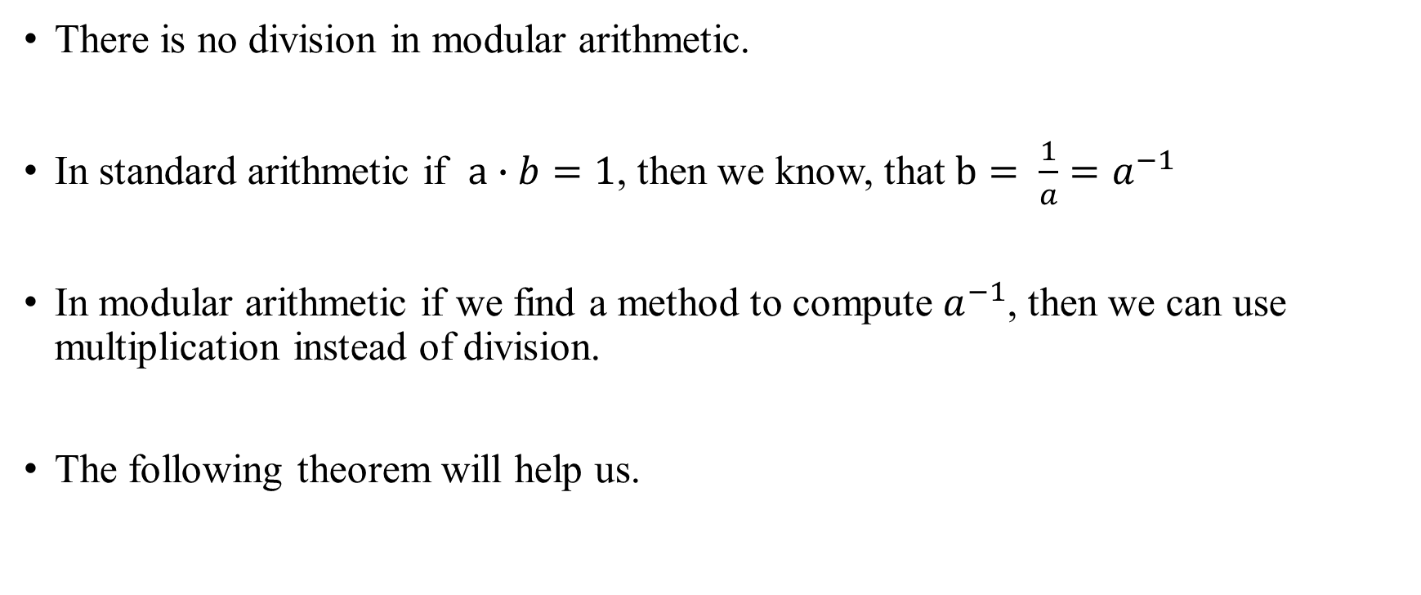
Modular arithmetic Operations
There is no division in modular arithmetic.
In standard arithmetic if $a∙b=1$, then we know, that $b= \frac{1}{a}=a^{−1}$
In modular arithmetic if we find a method to compute $a^{−1}$, then we can use multiplication instead of division.
The following theorem will help us.

Slide 6
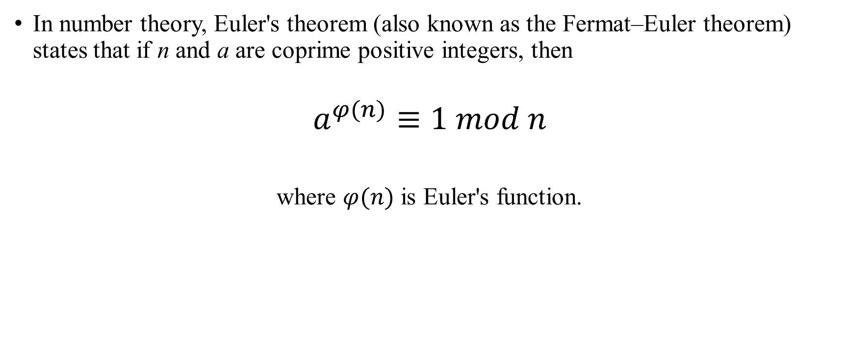
Modular arithmetic Euler’s theorem
In number theory, Euler's theorem (also known as the Fermat–Euler theorem) states that if n and a are coprime positive integers, then
$$a^{φ(n)}≡1 mod n$$
where $φ(n)$ is Euler's function.

Slide 7
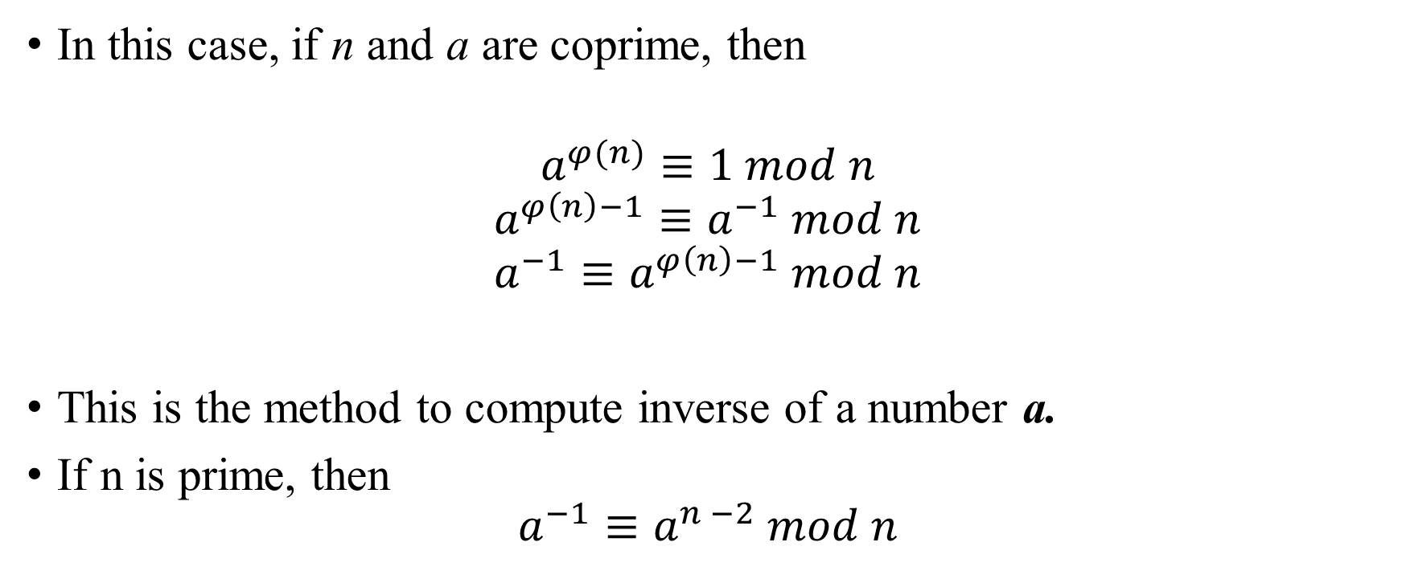
Modular arithmetic Inverse element calculation
In this case, if n and a are coprime, then
$$a^{φ(n)}≡1 mod n$$
$$a^{φ\left(n\right)−1}≡a^{−1} mod n$$
$$a^{−1}≡a^{φ\left(n\right)−1} mod n$$
This is the method to compute inverse of a number a.
If n is prime, then
$$a^{−1}≡a^{n −2} mod n$$

Slide 8

Modular arithmetic Inverse element calculation
For example, let’s find a in the following equation:
5 * a = 2 mod 7
a = $\frac{2}{5}$ mod 7
a = 2 $∙ 5^{−1}$ mod 7
a = 2 $∙ 5^{5}$ mod 7
a = 2 $∙31$25 mod 7
a = 6250 mod 7
a = 6 mod 7

Slide 9
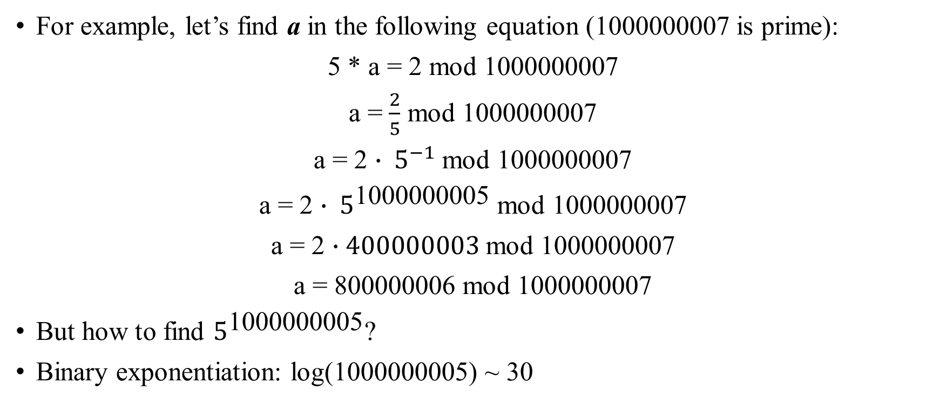
Modular arithmetic Inverse element calculation
For example, let’s find a in the following equation (1000000007 is prime):
5 * a = 2 mod 1000000007
a = $\frac{2}{5}$ mod 1000000007
a = 2 $∙ 5^{−1}$ mod 1000000007
a = 2 $∙ 5^{\text{10000000}\text{05}}$ mod 1000000007
a = 2 $∙400000003$mod 1000000007
a = 800000006 mod 1000000007
But how to find $5^{\text{10000000}\text{05}}$?
Binary exponentiation: log(1000000005) ~ 30

